Slide 1
What is Git?

Slide 2
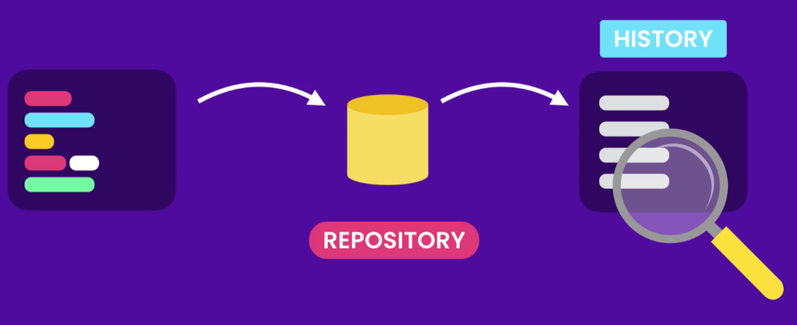
What is Git?
Git is a technology that can be used to track changes to a project and to help multiple people to collaborate on a project.
At a basic level, a project version controlled by Git consists of a folder with files in it, and Git tracks the changes that are made to the files in the project.
This allows you to save different versions of the work you’re doing, which is why we call Git a version control system.

Slide 3
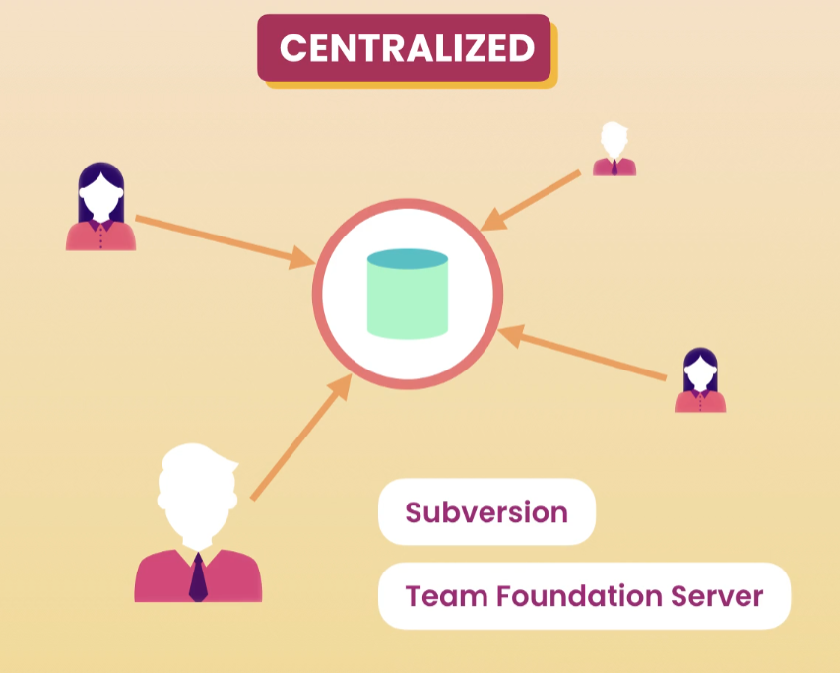
Version Control System
Single Point of Failure

Slide 4
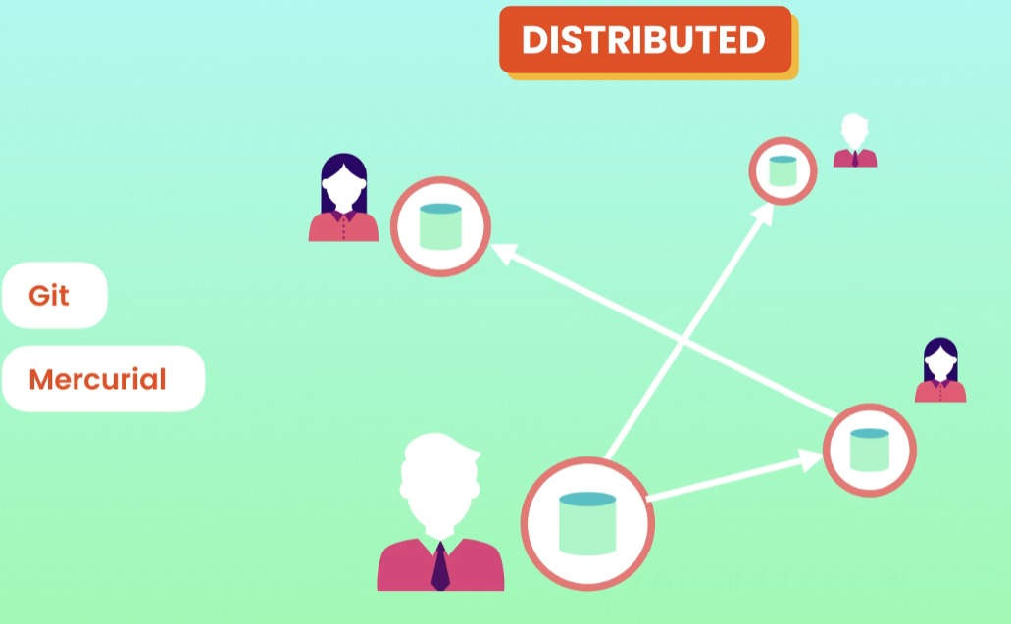
Version Control System

Slide 5
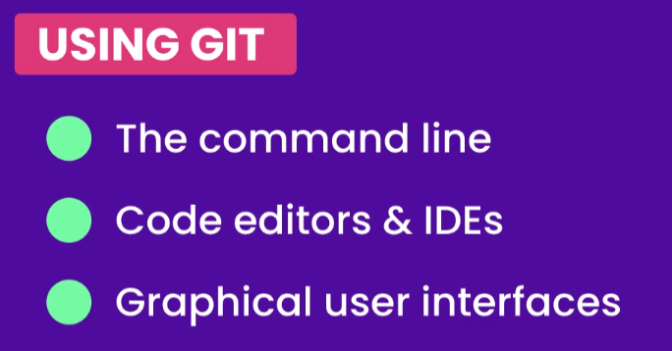
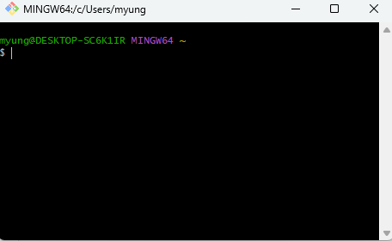
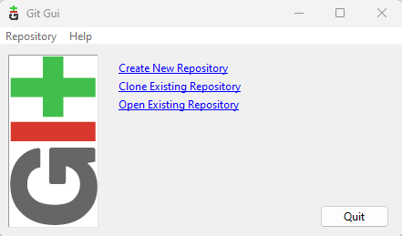
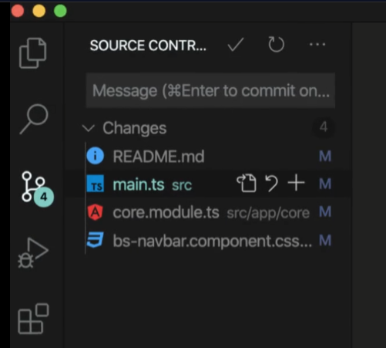
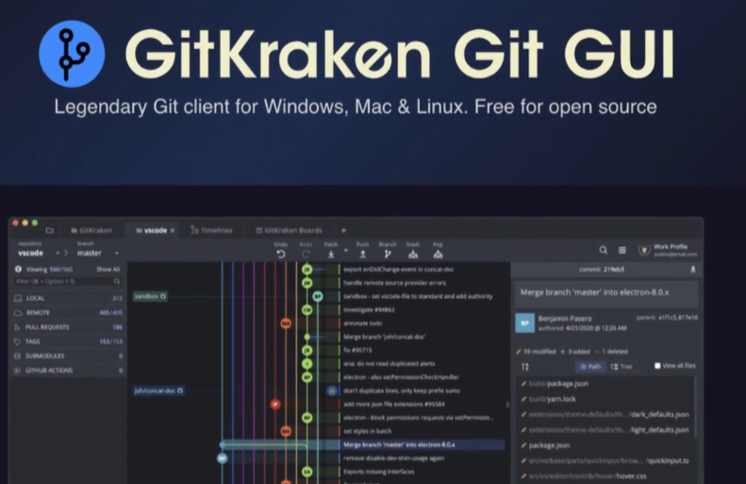
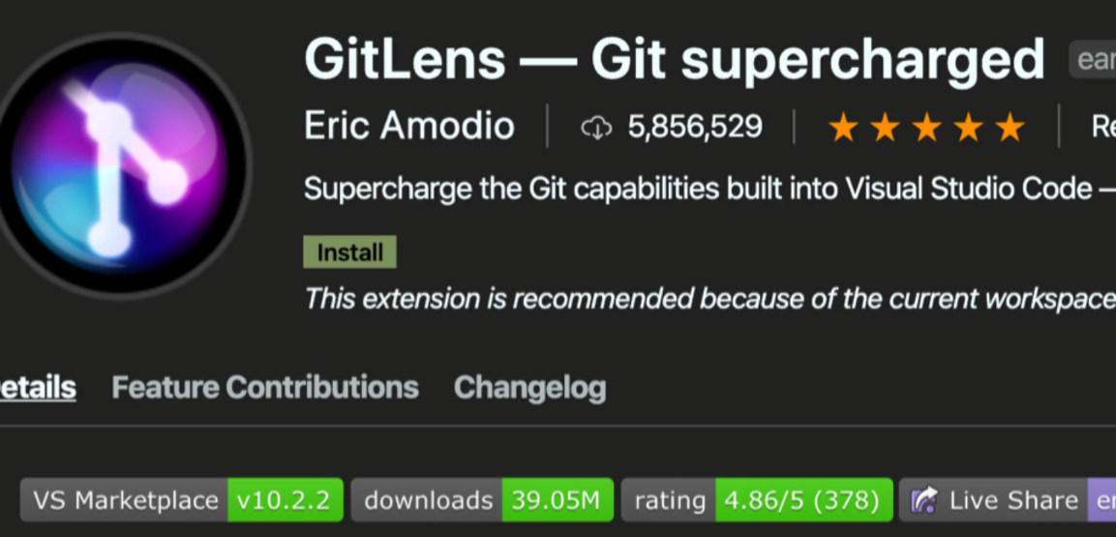
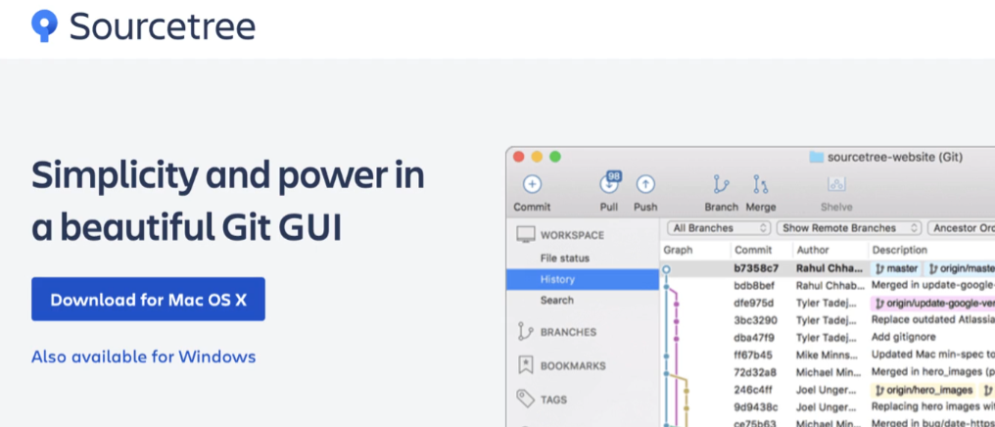
Git Bash vs GUI

Slide 6
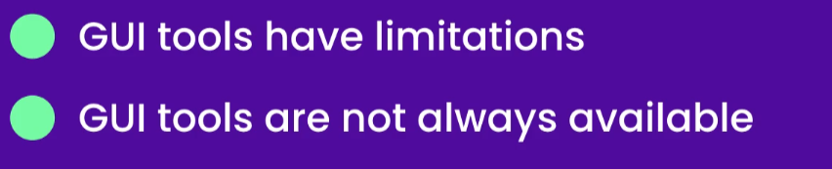
Why Command Line

Slide 7
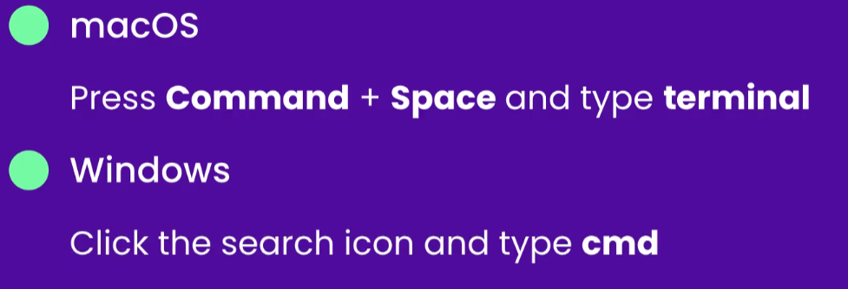
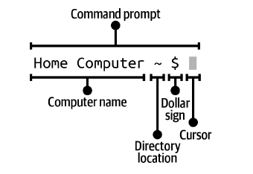
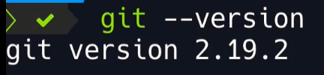
Command Prompt
macOS — the command line application is called Terminal.
Microsoft Windows — the command line application is called Git Bash.

Slide 8
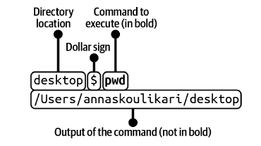
Executing Commands in the Command Line

Slide 9
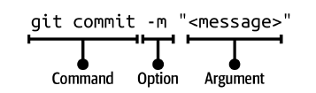






Command Options and Arguments
-m is the option and <message> is the argument

Slide 10
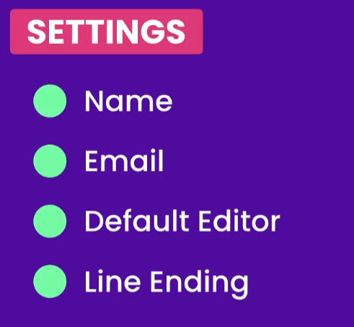
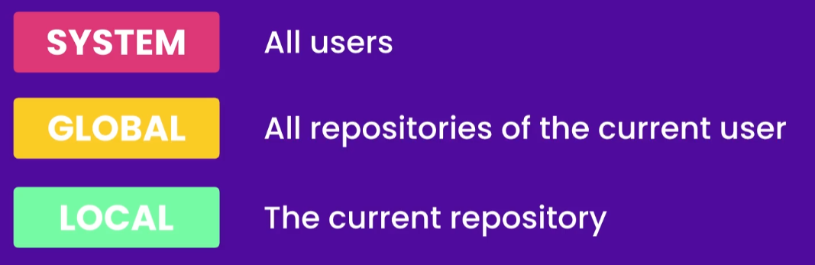

Configuring Git

Slide 11
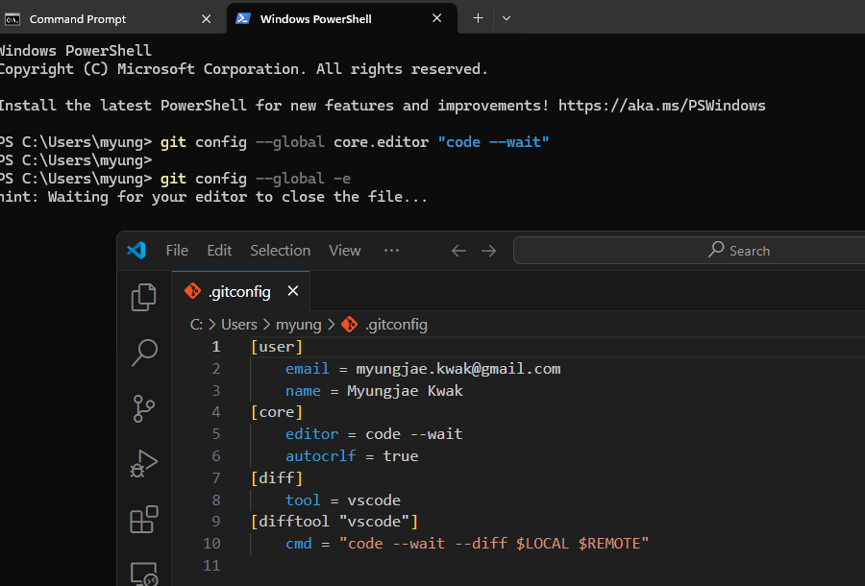
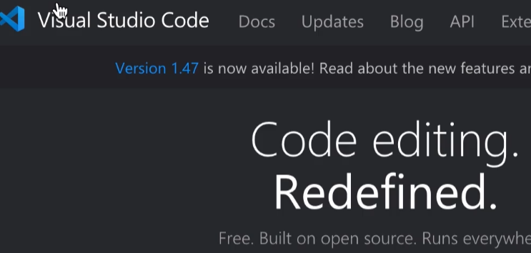
Default Editor

Slide 12
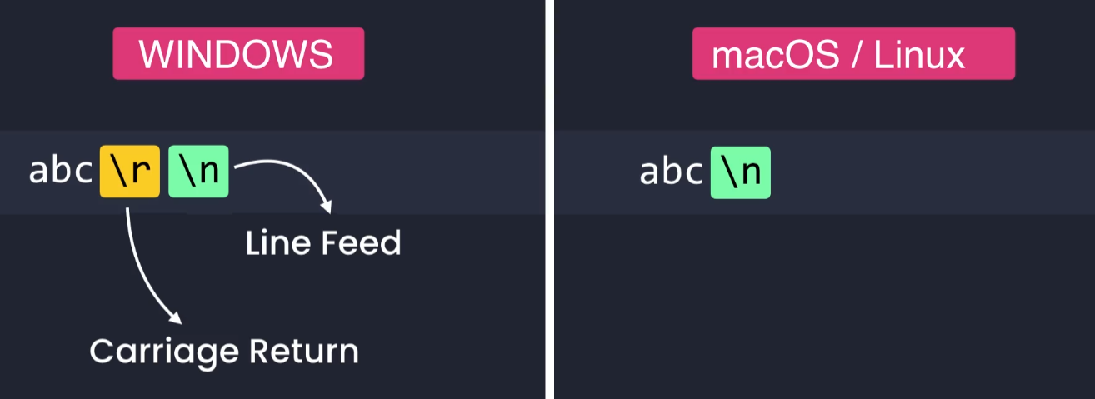
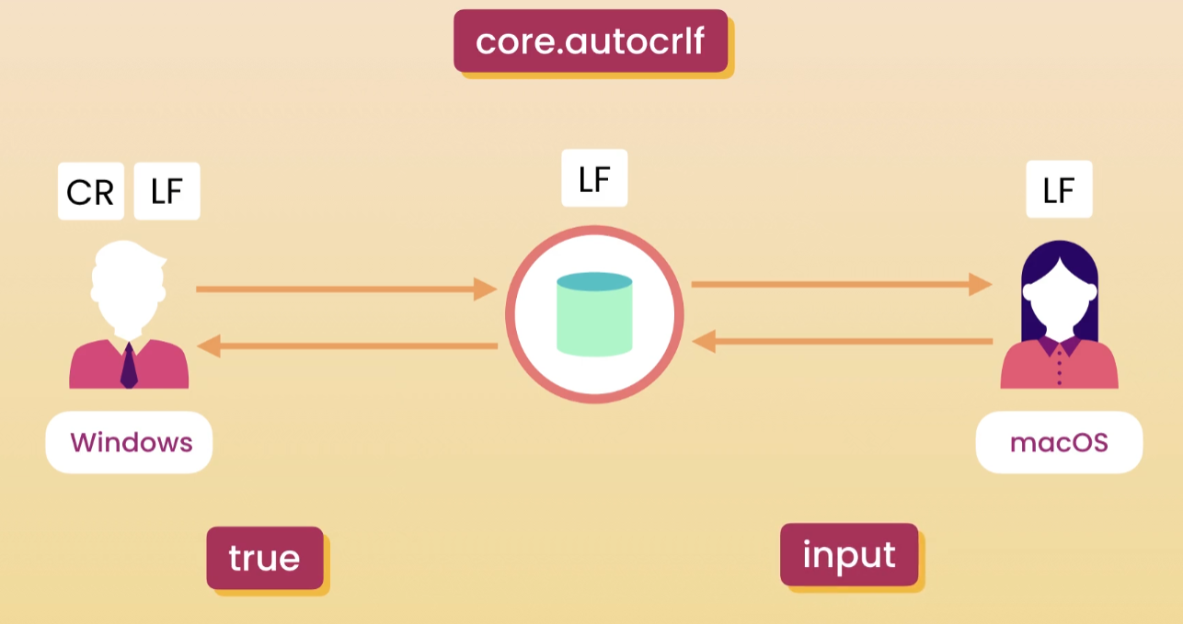
autocrlf

Slide 13
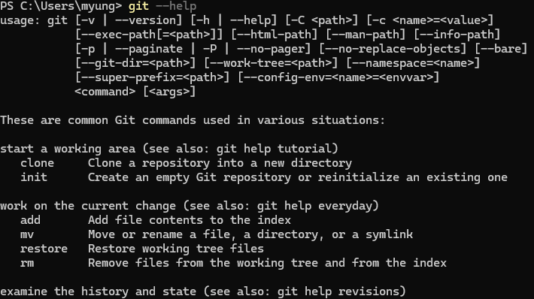
Getting Help
Git Documentation - https://git-scm.com/docs

Slide 14
Cheat Cheet
Refer to - Git Cheat Sheet.pdf

